Slide 1
Structure of matter
1

Slide 2
MIXTURE: When two or more elements or compounds are mixed together, and there is no chemical change between them, we get a mixture of the elements or compounds. In a mixture, no new molecules are formed.
2/10

Slide 3
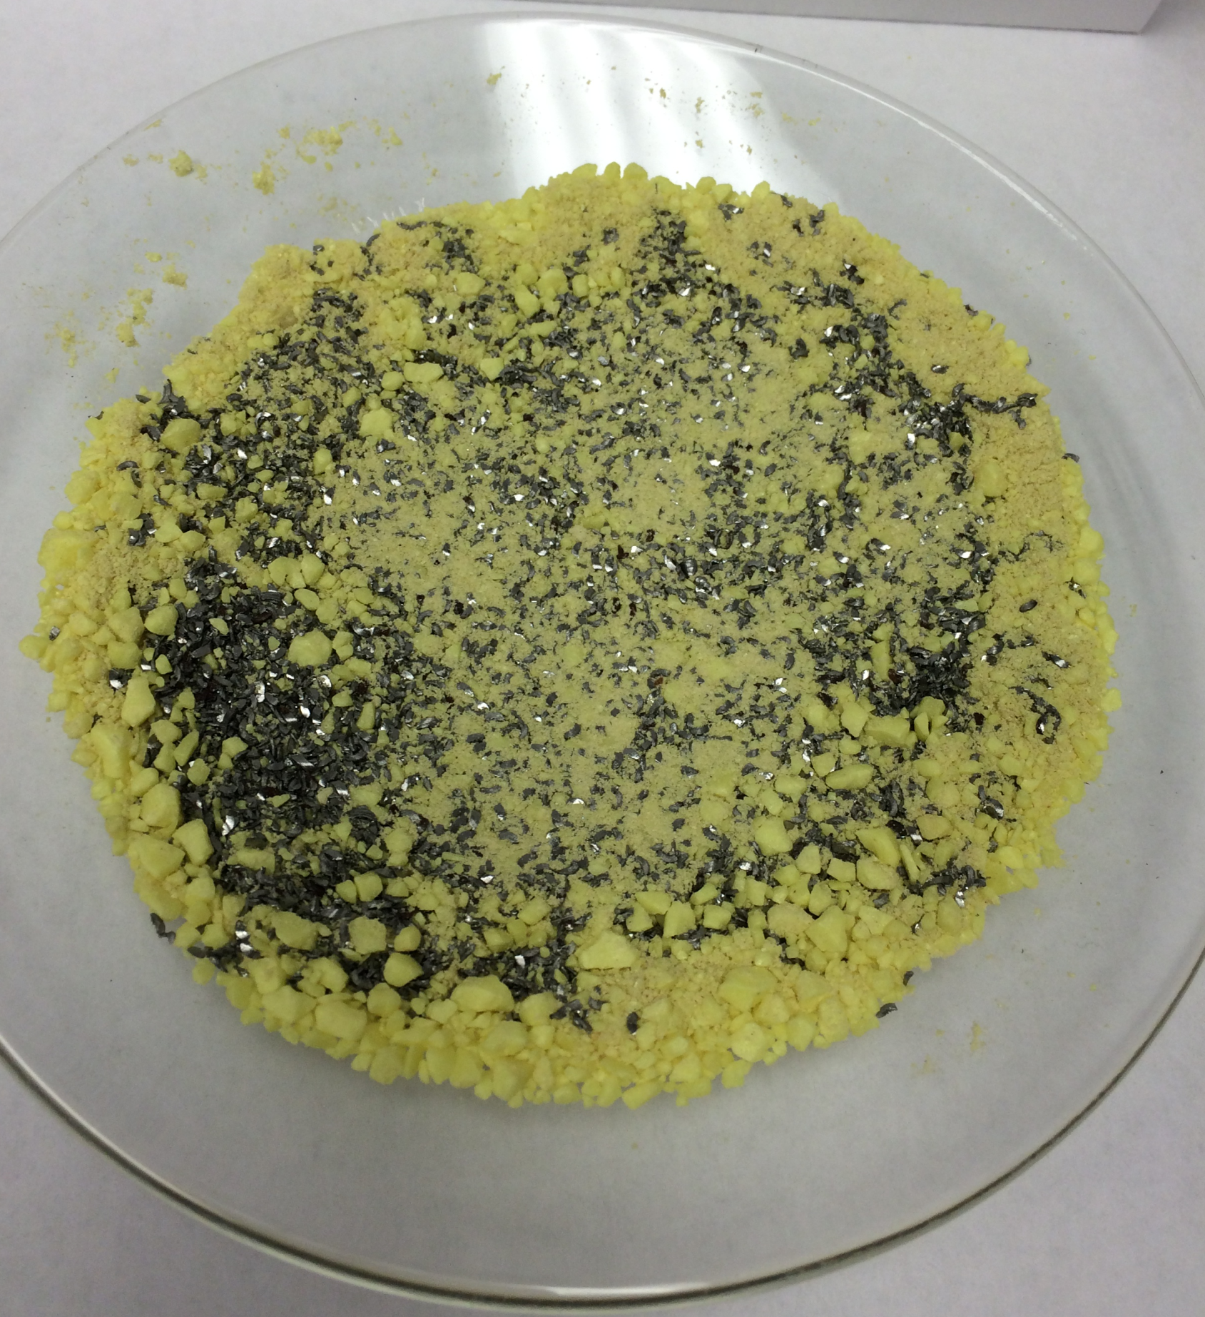
Mixture of Iron and sulphur
3/10

Slide 4
Difference between mixture and compound: While a mixture can be made by mixing together two or more elements or compounds in any ratio, a compound is always made up of elements combined in a certain fixed ratio that always remain the same.

Slide 5
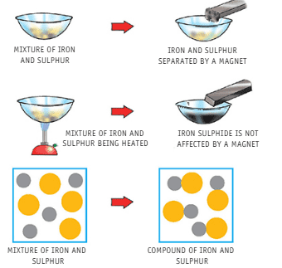
QUESTIONS RELATED TO ABOVE SLIDES

Slide 6
Compounds
1. One molecule of iron sulphide contains
1 atom of iron and 1 atom of sulphur. 2. If we use 20 g of iron powder and 8 g of sulphur, and heat the mixture, the reaction will still take place.
But, the extra 6 g of iron will be left over.
3.Had there been extra sulphur in the mixture, that
would also have been left over. 4.This shows that in iron sulphide, iron and sulphur are present in a fixed ratio by weight. 5.This ratio is always 14:8 or 7:4. If the mixture contains iron or sulphur more than this fixed ratio, then the extra sulphur or iron will be left over.
6/10

